Slide 1
Artificial Intelligence for Games Week 4 – Pathfinding 2 Steve Rabin
For help on projects, email everyone (select and copy this string from the start of any class PowerPoint):
steve.rabin@gmail.com, p.jiankai@digipen.edu, b.hsu@digipen.edu, zak.s@digipen.edu, keaton.sullivan@digipen.edu, john.tseng@digipen.edu, a.roulst@digipen.edu
TAs: Jian Kai Phua, Brandon Hsu, Zak Stephenson, Keaton Sullivan, John Tseng, Andrew Roulst

Slide 2


Slide 3
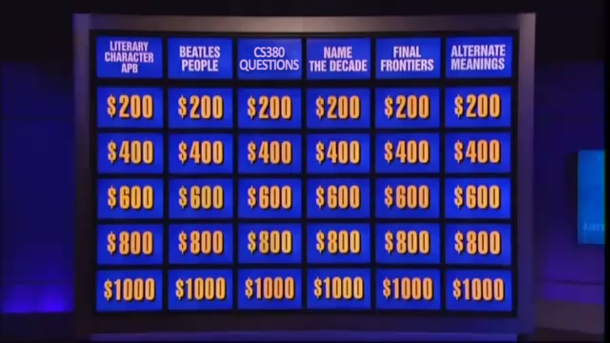

Slide 4


Slide 5

PATHFINDING SEARCH SPACE REPRESENTATIONS ARE ALL THIS KIND OF DATA STRUCTURE

Slide 6
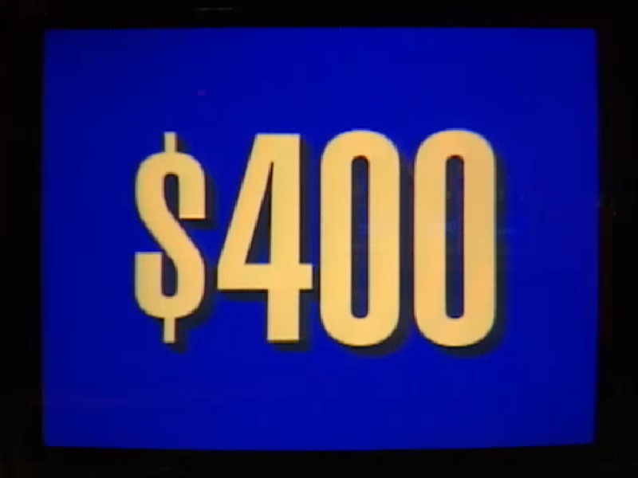

Slide 7
THIS IS THE EXHAUSTIVE LIST OF ALL PATHFINDING SEARCH SPACE REPRESENTATIONS

Slide 8


Slide 9
THESE TWO PATHFINDING SEARCH SPACE REPRESENTATIONS DO NOT REPRESENT THE WALKABLE SURFACE AREA

Slide 10
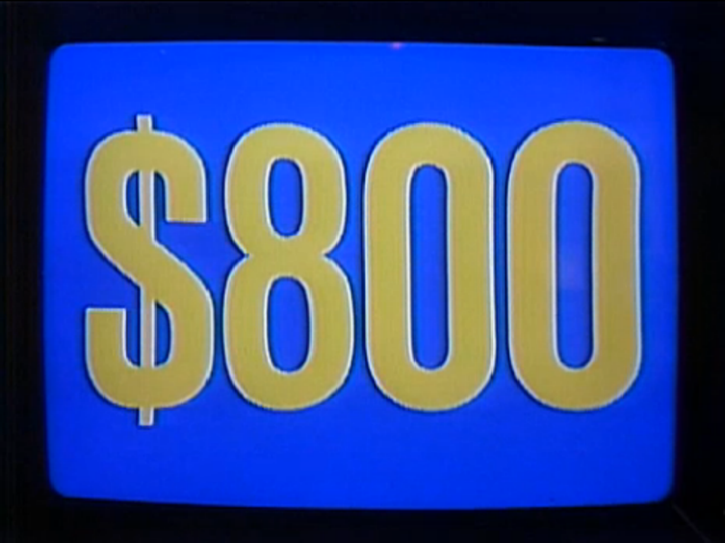

Slide 11
THIS SEARCH SPACE REPRESENTATION TYPICALLY HAS THE MOST NODES

Slide 12
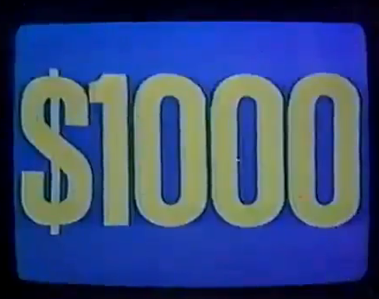

Slide 13
THIS SEARCH SPACE REPRESENTATION TYPICALLY HAS THE FEWEST NODES

Slide 14


Slide 15
THIS IS THE REASON THAT FLYING AGENTS TYPICALLY DO NOT NEED TO PATHFIND

Slide 16
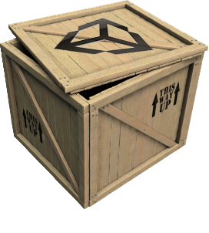
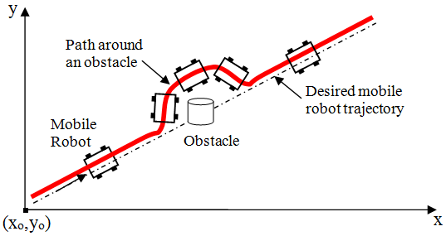
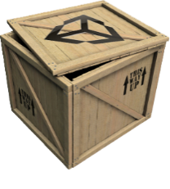
Local Obstacle Avoidance

Slide 17
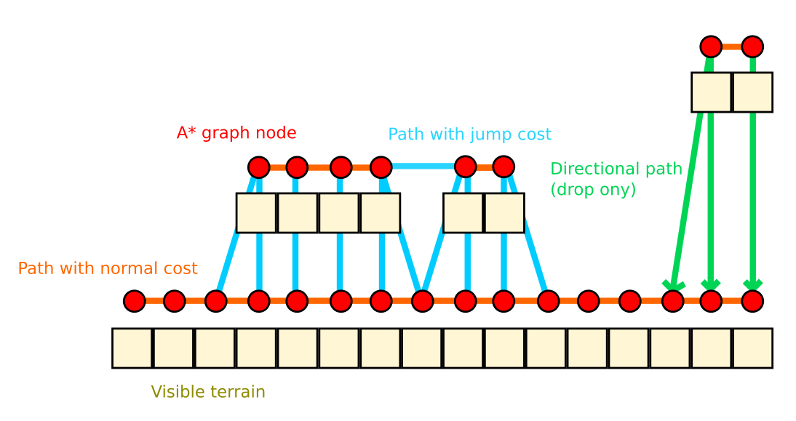
Ledges and Jumps

Slide 18
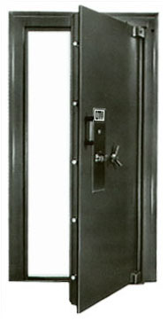
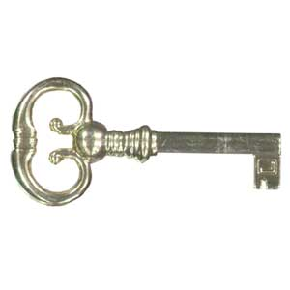
Doors, Elevators, etc.
Smart pathfinding nodes
Annotated with required action

Slide 19
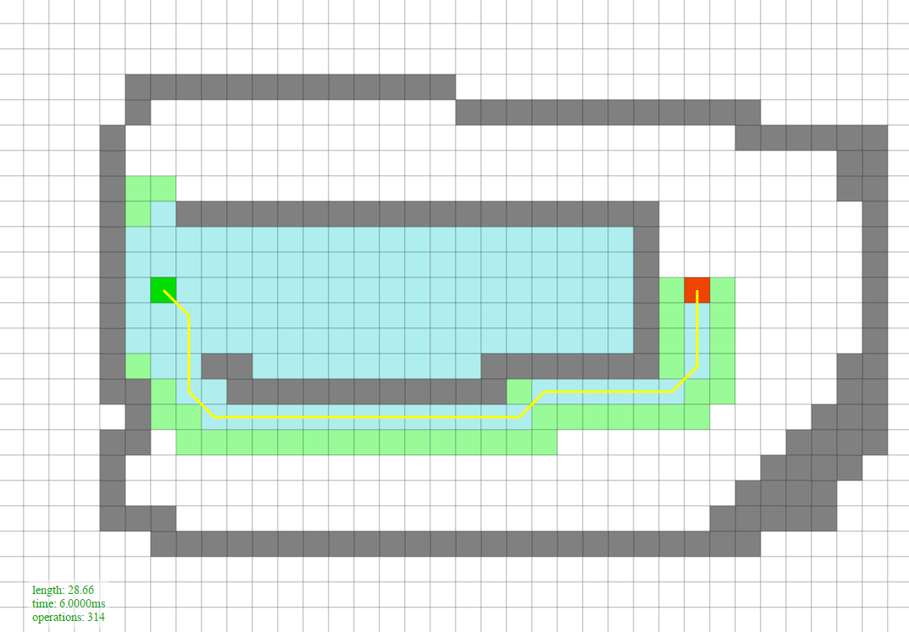
Search

Slide 20
Judging Search Algorithms
Quality of path
Shortest?
Optimal, near-optimal, or a reasonable path
Resource requirements
CPU, memory
Completeness
Will find a path if one exists

Slide 21
Pathfinding Search Algorithms
Random Bounce
Robust Trace
Breadth-First
Depth-First
Dijkstra
Greedy Best-First
A*
Jump Point Search (JPS+)
Roy-Floyd-Warshall

Slide 22
Open and Closed Lists
Open List
Promising nodes not yet explored
Closed List
Nodes already explored

Slide 23
Grid Search Space: Node Structure
Node* parent; // Parent (in general)
float cost; // Cost

Slide 24
Search Algorithm Structure
1. Push Start Node onto the Open List
2. While (Open List not empty)
a. Pop a node from the Open List (parent node)
b. If node is Goal Node, then return path
c. Find neighboring child nodes and score them
d. Conditionally add them to the Open List
e. Place parent node on the Closed List

Slide 25
PathDemo

Slide 26
A*
Combines Dijkstra and Greedy Best-First
Given cost and Heuristic cost
Open List sorted by:
Final cost = Given cost + Heuristic cost
f(x) = g(x) + h(x)
Final cost = Given cost + (Heuristic cost * weight)
f(x) = g(x) + (h(x) * weight)

Slide 27
A*
Completeness
Heuristic Search
Admissible heuristic = Optimal path
Factoid: An admissible heuristic does nothing for Greedy Best First.
This is a challenge. The closer you get to the true cost, the more efficient A* will be. But if you go over, A*will no longer guarantee an optimal path.
Factoid: A heuristic guess of zero is admissible! A* will just become Dijkstra if h(x) = 0.

Slide 28
Recap of Search Algorithms
Guarantee a path is found if it exists (completeness)
Breadth-First, Depth-First, Dijkstra, A* and all variants
Guarantee an optimal path
Dijkstra, A* and all variants (if admissible heuristic)
Heuristic search algorithms (smart, head toward goal)
Greedy Best-First, A* and all variants

Slide 29
Search

Slide 30
A* Algorithm
If (request.newRequest) {
Initialize everything. Clear Open/Closed Lists.
Push Start Node onto the Open List with cost of f(x) = g(x) + h(x).
}
While (Open List is not empty) {
parentNode = Pop cheapest node off Open List.
If parentNode is the Goal Node, then path found (return PathResult::COMPLETE).
Place parentNode on the Closed List.
For (all neighboring child nodes of parentNode) {
Compute its cost, f(x) = g(x) + h(x)
If child node isn’t on Open or Closed list, put it on Open List.
Else if child node is on Open or Closed List, AND this new one is cheaper,
then take the old expensive one off both lists and put this new
cheaper one on the Open List.
}
If taken too much time this frame (or if request.settings.singleStep == true),
abort search for now and resume next frame (return PathResult::PROCESSING).
}
Open List empty, thus no path possible (return PathResult::IMPOSSIBLE).

Slide 31
A* Worksheet

Slide 32
A*
Combines Dijkstra and Greedy Best-First
Given cost and Heuristic cost
Open List sorted by:
Final cost = Given cost + Heuristic cost
f(x) = g(x) + h(x)
Final cost = Given cost + (Heuristic cost * weight)
f(x) = g(x) + (h(x) * weight)

Slide 33
A*
Completeness
Heuristic Search
Admissible heuristic = Optimal path
Factoid: An admissible heuristic does nothing for Greedy Best First.
This is a challenge. The closer you get to the true cost, the more efficient A* will be. But if you go over, A*will no longer guarantee an optimal path.
Factoid: A heuristic guess of zero is admissible! A* will just become Dijkstra if h(x) = 0.

Slide 34
Search

Slide 35
A* Algorithm
If (request.newRequest) {
Initialize everything. Clear Open/Closed Lists.
Push Start Node onto the Open List with cost of f(x) = g(x) + h(x).
}
While (Open List is not empty) {
parentNode = Pop cheapest node off Open List.
If parentNode is the Goal Node, then path found (return PathResult::COMPLETE).
Place parentNode on the Closed List.
For (all neighboring child nodes of parentNode) {
Compute its cost, f(x) = g(x) + h(x)
If child node isn’t on Open or Closed list, put it on Open List.
Else if child node is on Open or Closed List, AND this new one is cheaper,
then take the old expensive one off both lists and put this new
cheaper one on the Open List.
}
If taken too much time this frame (or if request.settings.singleStep == true),
abort search for now and resume next frame (return PathResult::PROCESSING).
}
Open List empty, thus no path possible (return PathResult::IMPOSSIBLE).

Slide 36
Recap of Search Algorithms
Guarantee a path is found if it exists (completeness)
Breadth-First, Depth-First, Dijkstra, A* and all variants
Guarantee an optimal path
Dijkstra, A* and all variants (if admissible heuristic)
Heuristic search algorithms (smart, head toward goal)
Greedy Best-First, A* and all variants

Slide 37
Project Code

Slide 38
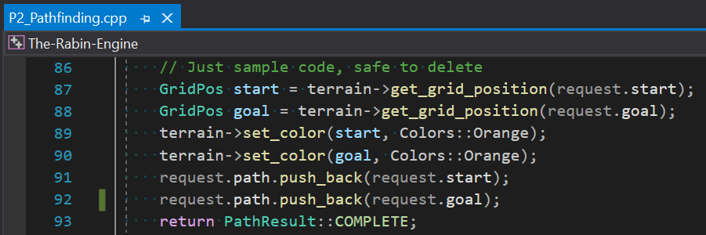
Project 2: Pointers
Edit code in Student/Project_2
Extra credit must enable the bools at the top of P2_Pathfinding.cpp.
Check out Terrain.h for accessing the map. Get to it through “terrain->”. See the bottom of P2_Pathfinding.cpp for examples.
PathRequest structure has a “newRequest” Boolean. Use this to know if it’s the first time and you need to initialize the search (versus continue where you left off).
Push the nodes of the path onto “request.path” like the example at the bottom of P2_Pathfinding.cpp.

Slide 39
Grid Search Space: Node Structure
Node* parent; // Parent
GridPos gridPos; // Node’s location
float finalCost; // Final cost f(x)
float givenCost; // Given cost g(x)
enum onList; // On open/closed list?
SMALLER DATA STRUCTURE = FASTER SEARCH

Slide 40
Project 2: More Pointers
Pre-allocate all nodes (40x40 is the biggest map)
Clear the node data before each search
Do not have an actual closed list (use the enum inside each node)
If you are interested in the speed contest:
On a map change calculate all valid neighbors per node
There might be other things you can precalculate on a map change, but do not precalculate all heuristics which is equivalent to Roy-Floyd-Warshall (which is extra credit)
Do not allocate ANY memory during the search
Minimize the size of the data in each node (put bigger objects first so it packs optimally)
Keep things together in the cache
Turn on all optimizations. Submit a Release build. Look into PGO.

Slide 41
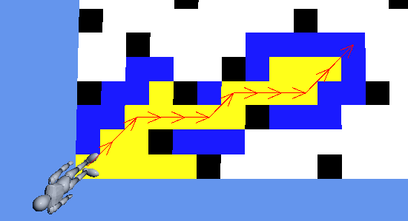
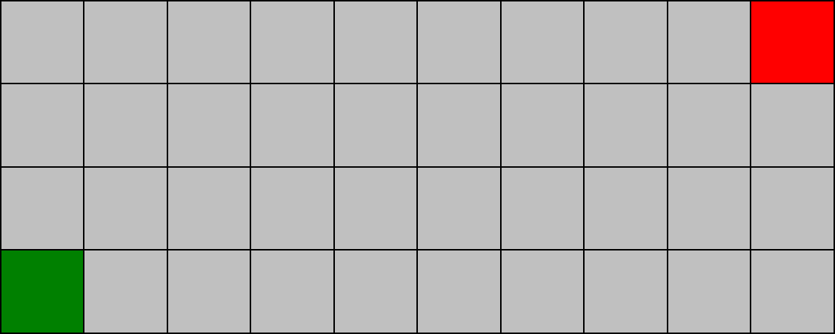
Project 2: Grading
Due 10/16 (3 weeks)
Absolute requirements (-50% for violating):
Draw the open list of quads as Blue and
the closed list of quads as Yellow.
The path must use diagonals
when optimal and doesn’t
run into corners.

Slide 42
Project 2: Grading
(5%) Draw one step of A* each frame (based on state of GUI Single Step toggle – defaults to On)
(5%) Calculate the heuristic using Euclidean, Octile, Chebyshev, Inconsistent, and Manhattan
(based on state of GUI toggle button)
(30%) The path is optimal with a heuristic weight of 1.0
Must pass all tests. No partial credit.
(10%) Less than 2x sample solution Speed Test time (your A* must be completely optimal)
(run SampleSolution.exe, click “Run Speed Test” button, look in Output folder, open SpeedTest_DATE.txt, look at “Fastest”)
(10%) Less than 1x sample solution Speed Test time (your A* must be completely optimal)
(10%) Less than 0.5x sample solution Speed Test time (your A* must be completely optimal) ← 0.5x is difficult
(15%) Rubberband final path where possible (use toggle)
Must use algorithm as described in class. (-15% if wrong)
Must have rubberbanding at beginning and end, so no off-by-one errors. (-5% if wrong)
(15%) Smooth using a Catmull-Rom spline (use toggle)
Must be 3 spline points in-between every waypoint. (-5% if wrong)
When combined with Rubberbanding, must add back in points if < 1.5 grid units between waypoints. (-5% if wrong)
(-10%) If it crashes at any time
(-50%) If fail to meet any of these requirements:
Open list drawn in Blue and Closed list drawn in Yellow.
Path uses diagonals when optimal and doesn’t run into corners.

Slide 43
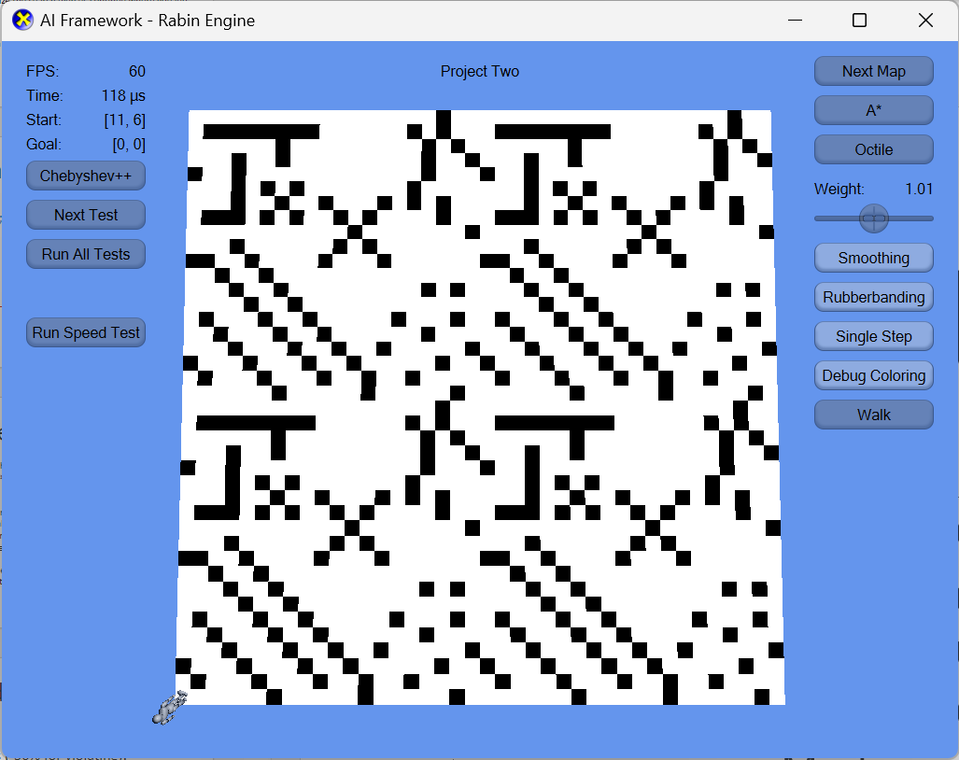
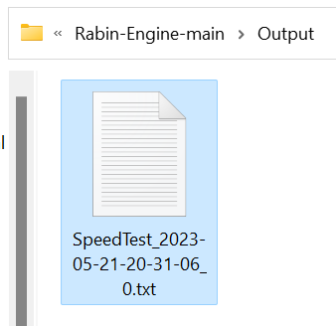
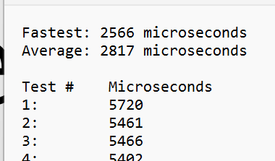
Speed Test
This speed is different on every computer depending on the CPU. You need to check your speed relative to SampleSolution.exe.
FACTOID: The fastest ever student project is 1/6 the speed of the SampleSolution.exe.

Slide 44
Project 2: Extra Credit
20% Implement Roy-Floyd-Warshall algorithm
In addition to A*
Must offer on-screen button to toggle on/off.
20% Implement Goal Bounding
Must offer an on-screen toggle to switch between A* and Goal Bounding. Hook it up to the timing.

Slide 45
Project 2: Extra Credit
20% be in top 4 fastest class times on an A* search
(top 4 across all students in both CS380 sections)
“Run Speed Test” button in GUI
A*, Octile, No rubberbanding or smoothing
No precomputing all heuristics
No precomputing all paths
No caching paths or heuristics
Always search from start to goal (no ping-ponging)
Don’t invent a new search algorithm – it must be A*
Multi-threading or the GPU will be slower, so don’t do that

Slide 46
Hours Spent Fall 2018
Project 1: Behavior Trees
Median of 12 hours
Project 2: Pathfinding
Median of 20 hours
Project 3: Terrain Analysis
Median of 12 hours

Slide 47
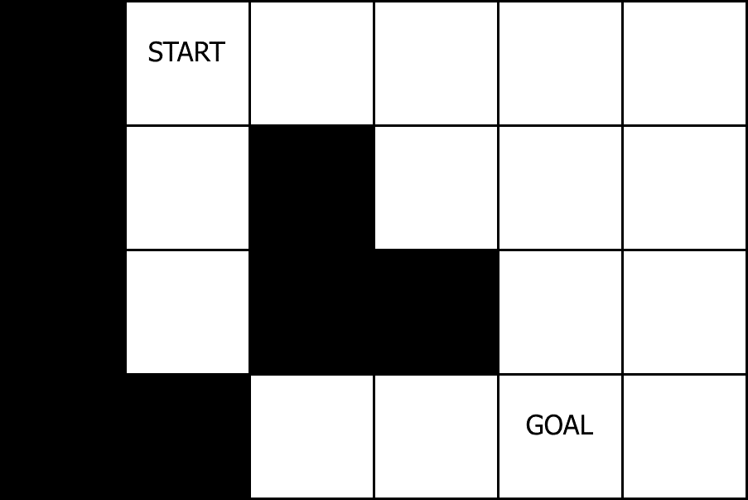
Diagonal Correctness

Slide 48
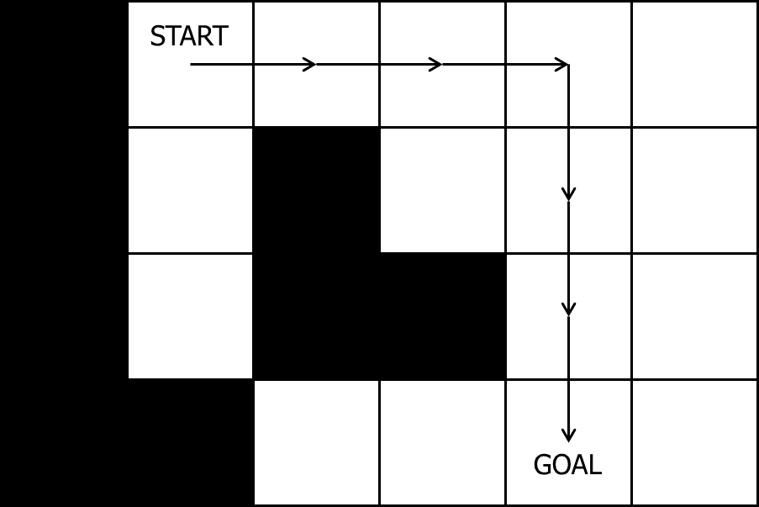
Diagonal Correctness: Wrong

Slide 49
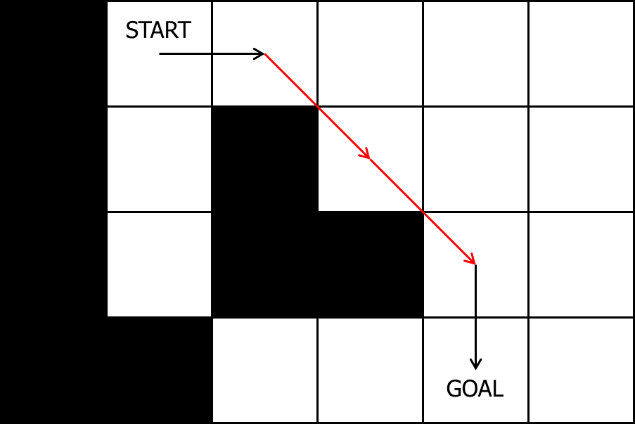
Diagonal Correctness: Wrong

Slide 50
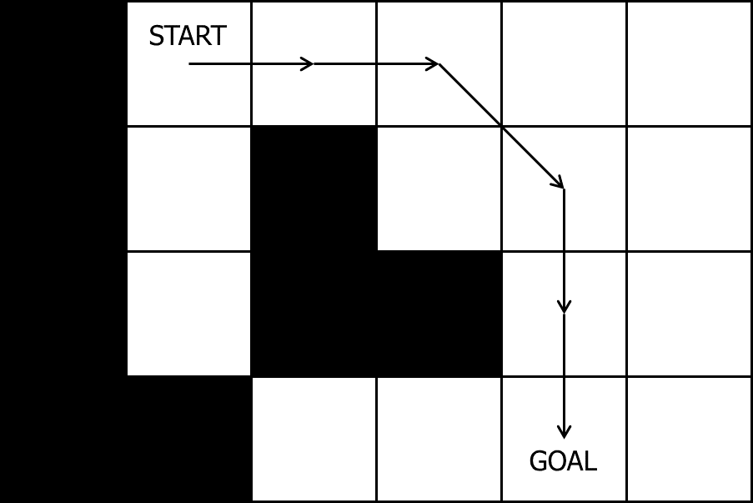
Diagonal Correctness: Correct

Slide 51
Grid Heuristic Calculations

Slide 52
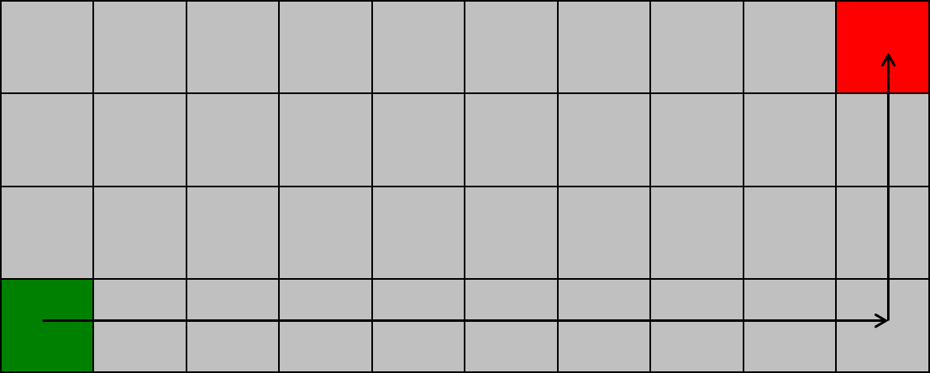
Manhattan distance
xDiff + yDiff = 9 + 3 = 12

Slide 53
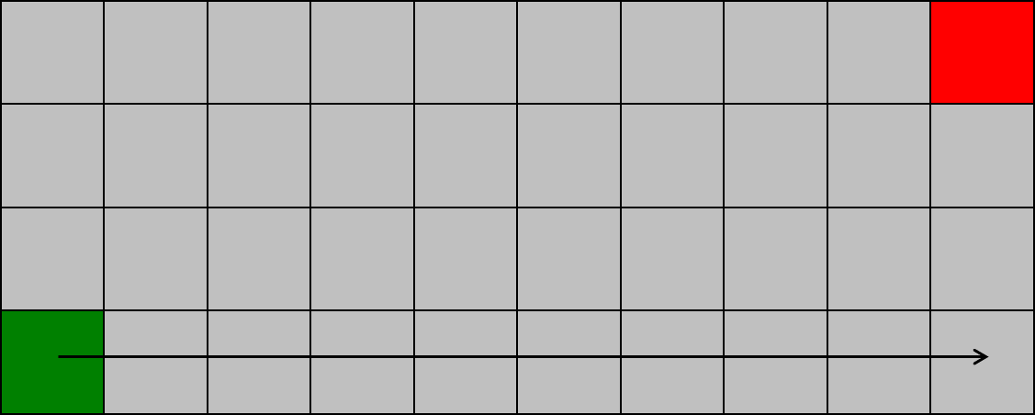
Chebyshev distance
max(xDiff, yDiff) = max(9, 3) = 9

Slide 54
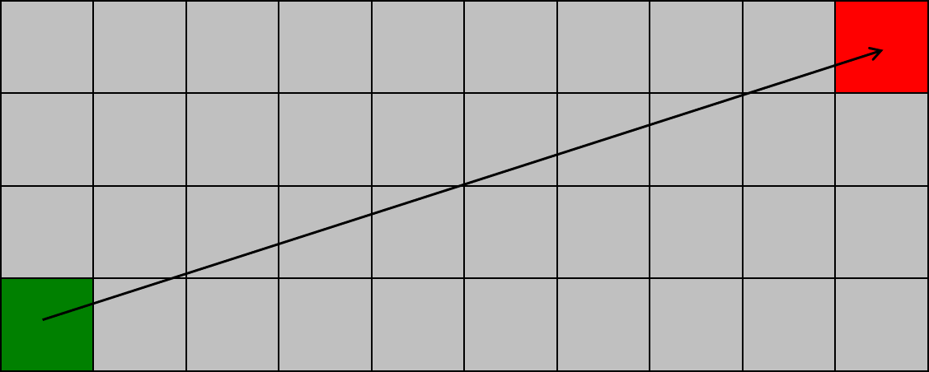
Euclidean distance
sqrt(xDiff² + yDiff²) = sqrt(9² + 3²) = 9.48

Slide 55
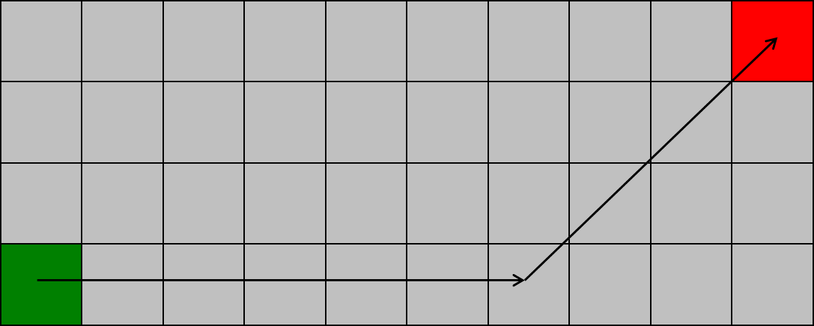
Octile distance
min(xDiff, yDiff) * sqrt(2) + max(xDiff, yDiff) – min(xDiff, yDiff)
min(9, 3) * 1.41 + max(9, 3) – min(9, 3) = 10.24

Slide 56
Which is Admissible? Which is Most Accurate?
Manhattan
Chebyshev
Euclidean
Octile

Slide 57
Which is Admissible? Which is Most Accurate?
Manhattan = 12
Chebyshev = 9
Euclidean = 9.48
Octile = 10.24

Slide 58
Inconsistent Heuristic Example
Use this code in your project for the inconsistent heuristic
C
To be consistent, a heuristic must obey the triangle inequality:
A → C ≤ A → B + B → A
Using the heuristic code to the right,
this code is an inconsistent heuristic:
(1,1)→(4,3) ≤ (1,1)→(2,1) + (2,1)→(4,3)
3.60 ≤ 1 + 0
3.60 ≤ 1
Does not obey the triangle inequality!
WARNING: An inconsistent heuristic results in some nodes on the Closed list having to go back on the Open list.
NOTE: An inconsistent heuristic still results in an optimal path.
3
2
if ((cur.row + cur.col) % 2 > 0)
{
return <Euclidean calculation>;
}
return 0;
A
B
1
1
2
3
4

Slide 59
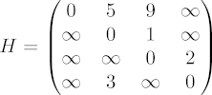
Roy-Floyd-Warshall All-Pairs Shortest Path
Pre-compute ALL paths
Just look up answer in a table!
1959 Bernard Roy
1962 Robert Floyd
1962 Stephen Warshall

Slide 60
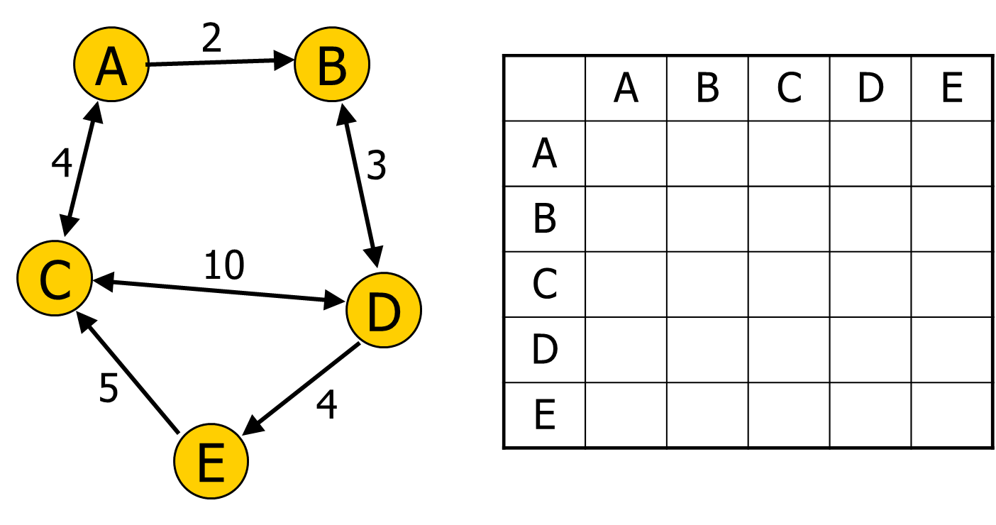
All-Pairs Shortest Path Table

Slide 61
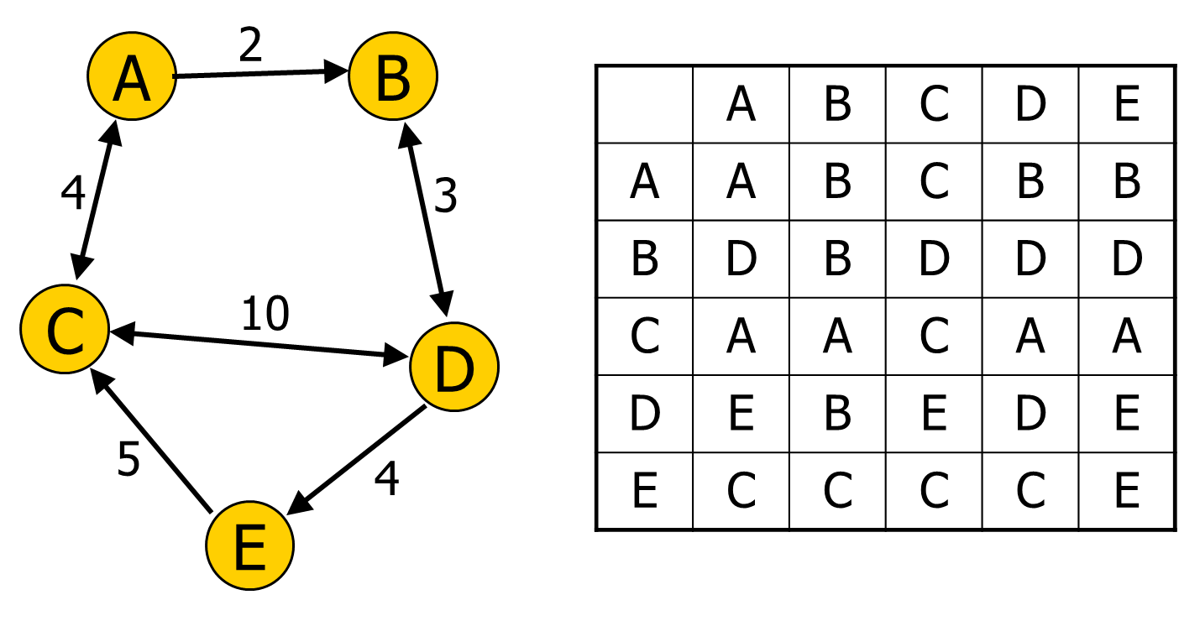
All-Pairs Shortest Path Table

Slide 62
int path[][]; //initialize to starting costs
void FloydWarshall()
{
for (k = 1 to n)
{
for each (i,j) in (1..n)
{
path[i][j] = min ( path[i][j],
path[i][k] + path[k][j] );
}
}
}

Slide 63
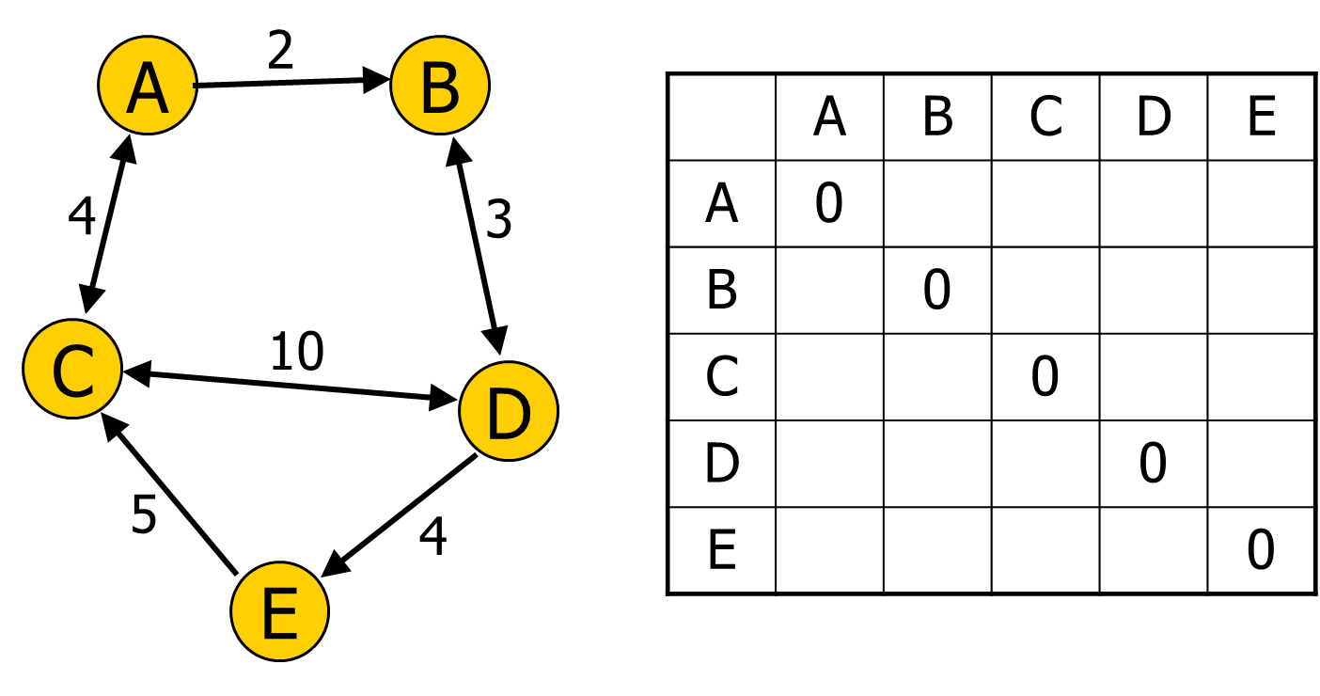
All-Pairs Shortest Path Table

Slide 64

All-Pairs Shortest Path Table

Slide 65

All-Pairs Shortest Path Table

Slide 66

All-Pairs Shortest Path Table

Slide 67
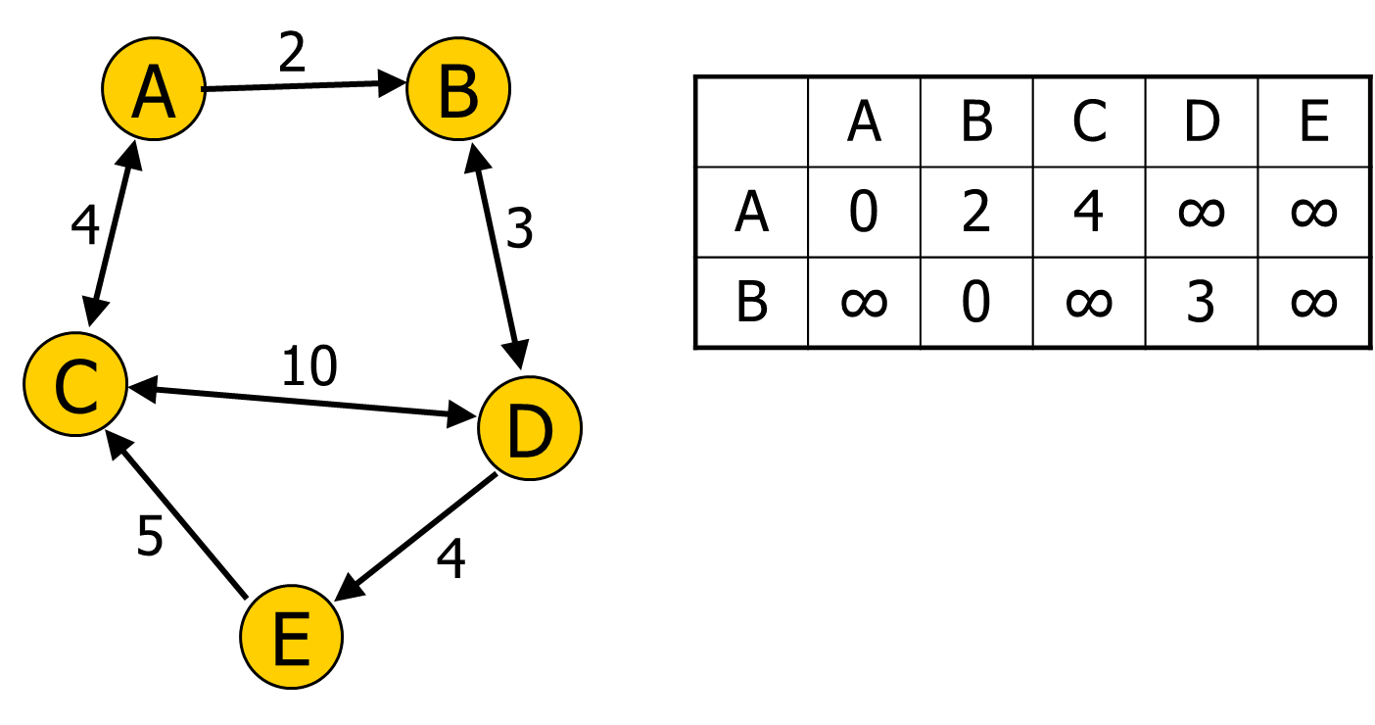
All-Pairs Shortest Path Table
for (k = 1 to n)
{
for each (i,j) in (1..n)
{
path[i][j] = min (path[i][j],
path[i][k] + path[k][j]);
}
}

Slide 68
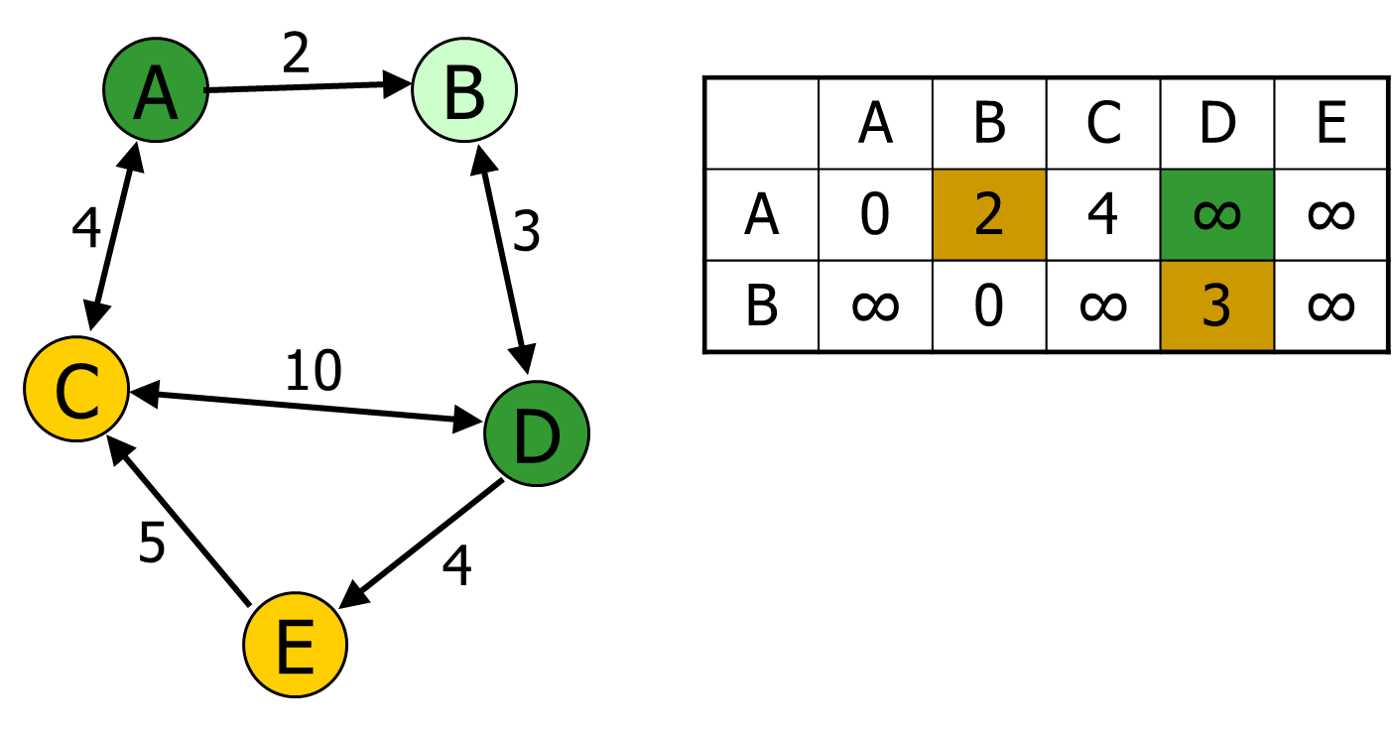
All-Pairs Shortest Path Table
for (k = 1 to n)
{
for each (i,j) in (1..n)
{ //example i=A, j=D, k=B
path[i][j] = min (path[i][j],
path[i][k] + path[k][j]);
}
}

Slide 69

All-Pairs Shortest Path Table
for (k = 1 to n)
{
for each (i,j) in (1..n)
{ //example i=A, j=D, k=B
path[i][j] = min (path[i][j],
path[i][k] + path[k][j]);
}
}

Slide 70

All-Pairs Shortest Path Table

Slide 71
All-Pairs Shortest Path Table

Slide 72
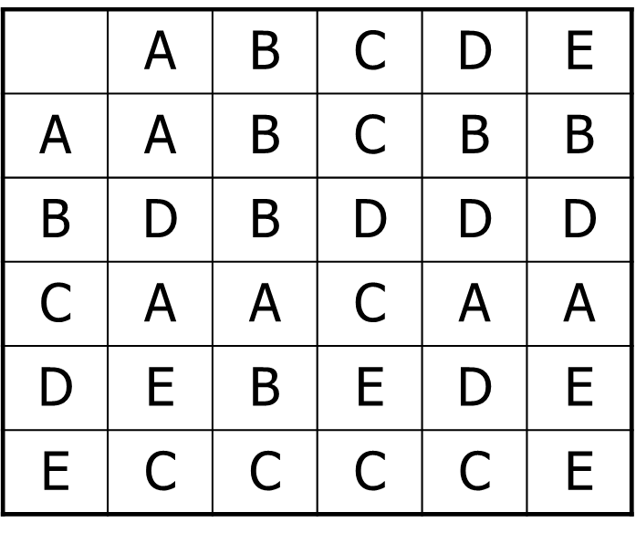
Roy-Floyd-Warshall All-Pairs Shortest Path
Speed of search?
Cost to compute?
What's the downside during runtime?
Which search space representations does it work on?

Slide 73
Overestimating the Heuristic Cost
A* combines Dijkstra and Best-First
Given cost and Heuristic cost
Final cost = Given cost + (Heuristic cost * weight)
f(x) = g(x) + (h(x) * weight)
Demo

Slide 74
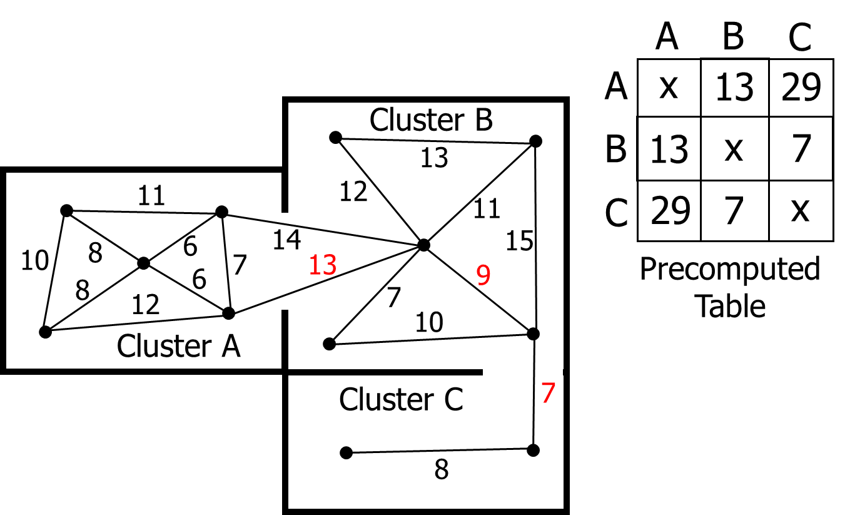
Cluster Heuristic

Slide 75
Two ways to sort the open list
Unsorted List
Pop: O(n) Brute force search for cheapest
Push: O(1) Trivial to push
Update: O(0) No work needed – List is not sorted
Priority Queue (binary tree)
Pop: O(log n)
Push: O(log n)
Update: O(n) Note: Typical P-Queues don’t have this

Slide 76

Unordered List Fast Array

Slide 77
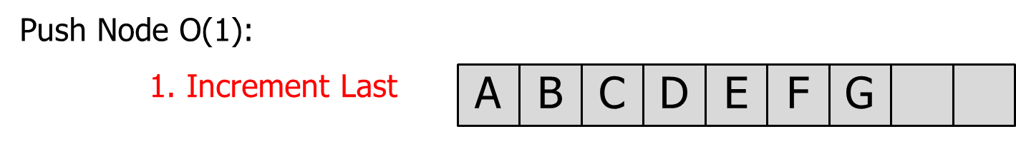
Unordered List Fast Array

Slide 78
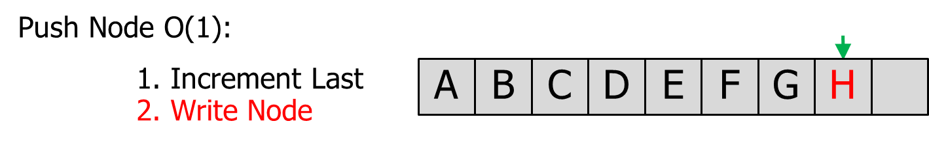
Unordered List Fast Array

Slide 79
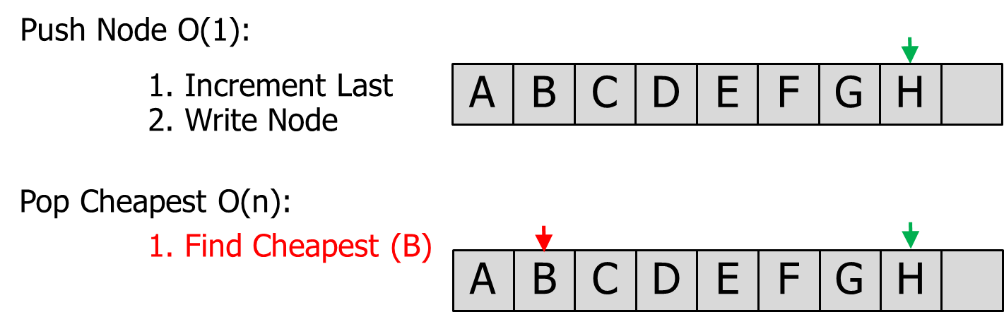
Unordered List Fast Array

Slide 80
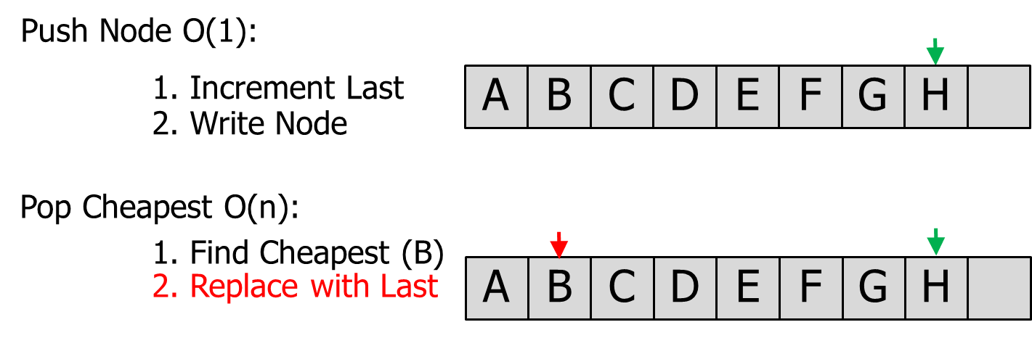
Unordered List Fast Array

Slide 81

Unordered List Fast Array
H

Slide 82
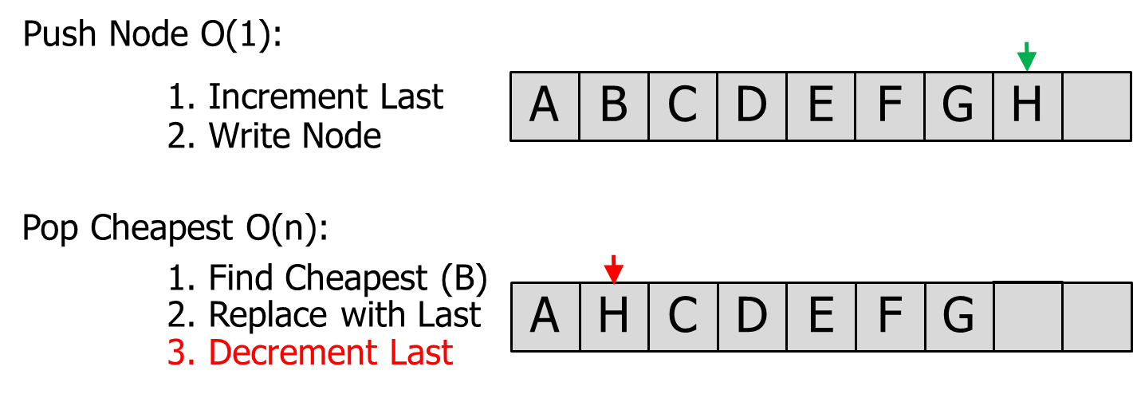
Unordered List Fast Array

Slide 83
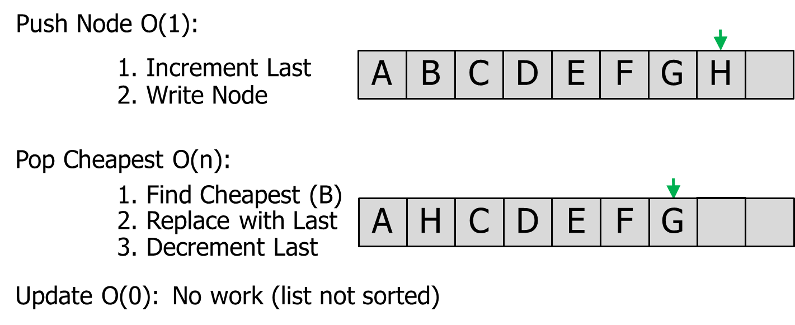
Unordered List Fast Array

Slide 84
Faster heap implementation
Generic Heap (Nathan Sturtevant)
Pop: O(log n)
Push: O(log n)
Update: O(1) Note: Uses a hash table
(function name is DecreaseKey)

Slide 85
Bucket Open List (fastest)
f(x)
Notes:
The size of each bucket should be tuned. Size of 1.0 is likely too big.
You need to choose a data structure to hold nodes inside each bucket (like Unsorted Array or Priority Queue).
Update the pointer to the lowest bucket when you Pop a node (move it upward until you find a bucket with nodes).
If you Push a node into a bucket lower than the current Pointer, move the Pointer to that lower bucket.
Bucket Open List is not used in games:
Might waste too much memory.
People might not know about this trick/technique.
7 to 8
6 to 7
This is just a pointer to a single pre-allocated node in the 40x40 array. Therefore, this f(x) cost is actually located in the Node struct. (Performance question: How does this affect cache coherency?)
5 to 6
5.7
4 to 5
4.1
3 to 4
Pointer to lowest bucket with nodes
(update this pointer as nodes are pushed or popped)
2 to 3
2.2
2.8
2.1
You need to figure out the best structure in each bucket. Recommendation: Start with an unordered list and see if you can improve from there.
1 to 2
0 to 1

Slide 86
Pathfinding Aesthetics

Slide 87
Pathfinding Aesthetics
We want to maximize responsiveness
How?
Don’t start moving until there is a path!
Stall for time:
Play an animation / sound clip until ready

Slide 88
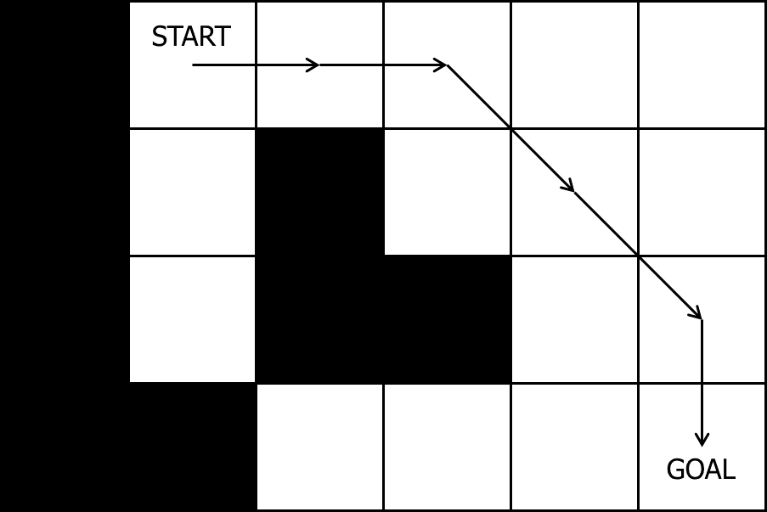
Post-Processing: Rubberbanding

Slide 89
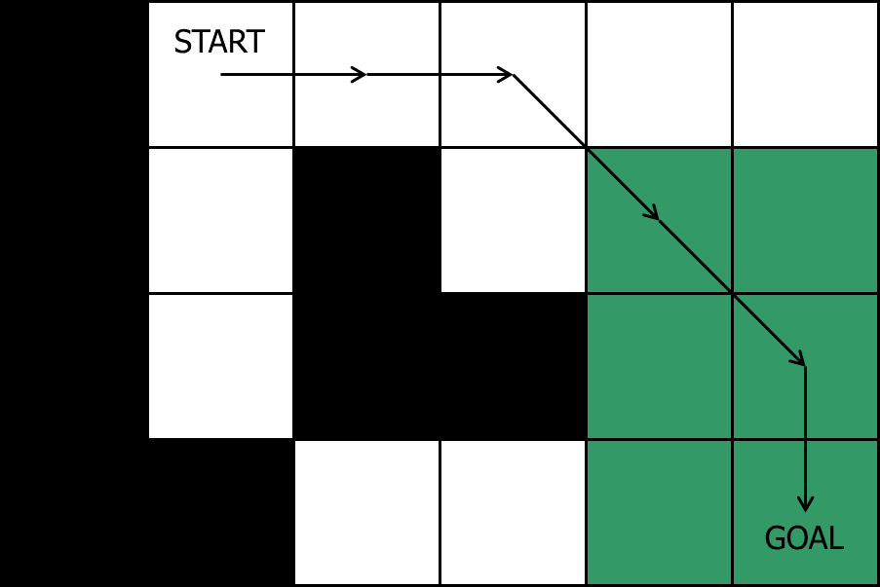
Rubberbanding: Can we eliminate the middle node?

Slide 90
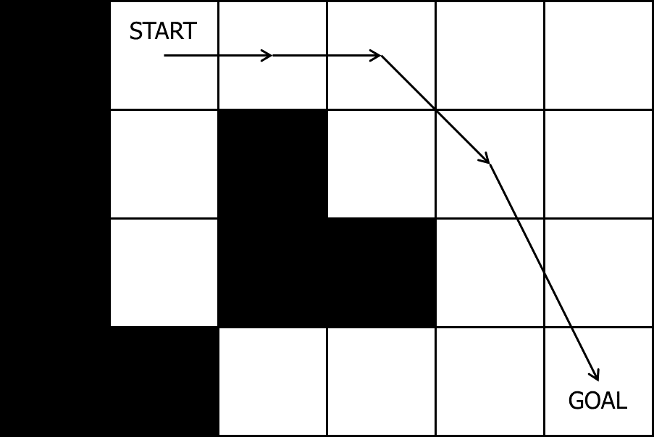
Rubberbanding: Middle node eliminated

Slide 91
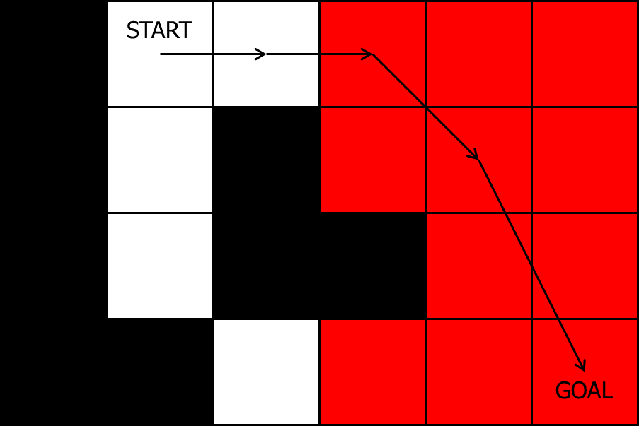
Rubberbanding: Can we eliminate the middle node?

Slide 92
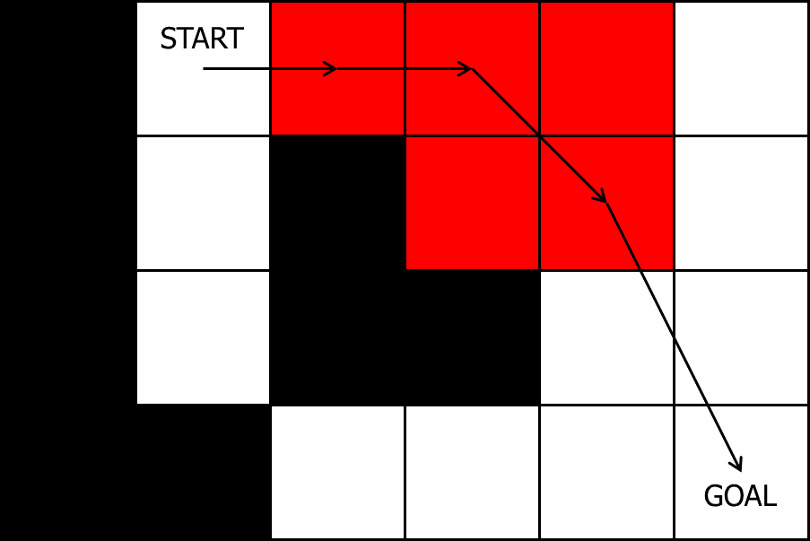
Rubberbanding: Can we eliminate the middle node?

Slide 93
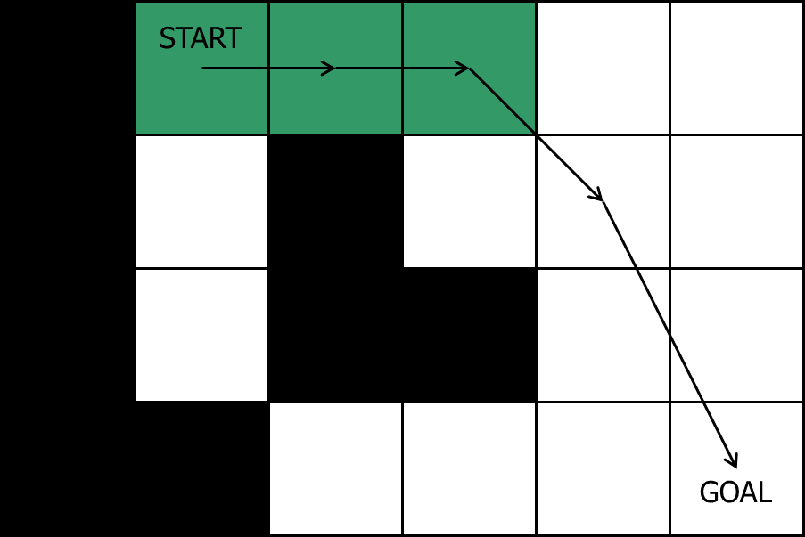
Rubberbanding: Can we eliminate the middle node?

Slide 94

Rubberbanding: Final path

Slide 95
Post-Processing: Smoothed Paths
Physics-based
At movement time – problems?
On waypoints before movement (demo)
Splines
Bezier Spline
Catmull-Rom Spline

Slide 96
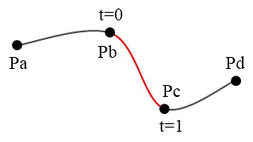
Catmull-Rom Spline
C1 continuity (not C2)
Passes through all control points

Slide 97
Catmull-Rom Spline
output_point =
point_1 * (-0.5*t*t*t + t*t – 0.5*t) +
point_2 * (1.5*t*t*t + -2.5*t*t + 1.0) +
point_3 * (-1.5*t*t*t + 2.0*t*t + 0.5*t) +
point_4 * (0.5*t*t*t – 0.5*t*t);
In SimpleMath.h:
static Vec3 Vec3::CatmullRom(
const Vec3& v1,
const Vec3& v2,
const Vec3& v3,
const Vec3& v4,
float t);
output_point
at t = 0.5
2
3
1
4

Slide 98
Algorithm to add in spline points
pOut = CatmullRom(v1, v2, v3, v4, t)

Slide 99
Algorithm to add in spline points
pOut = CatmullRom(v1, v2, v3, v4, t)
p1, p2
p3
p4

Slide 100
Algorithm to add in spline points
pOut = CatmullRom(v1, v2, v3, v4, t)
t = 0.25
pOut
p1, p2
p3
p4

Slide 101
Algorithm to add in spline points
pOut = CatmullRom(v1, v2, v3, v4, t)
t = 0.5
pOut
p1, p2
p3
p4

Slide 102
Algorithm to add in spline points
pOut = CatmullRom(v1, v2, v3, v4, t)
t = 0.75
pOut
p1, p2
p3
p4

Slide 103
Algorithm to add in spline points
pOut = CatmullRom(v1, v2, v3, v4, t)
p4
p1
p2
p3

Slide 104
Algorithm to add in spline points
pOut = CatmullRom(v1, v2, v3, v4, t)
p4
t = 0.25
pOut
p1
p2
p3

Slide 105
Algorithm to add in spline points
pOut = CatmullRom(v1, v2, v3, v4, t)
p4
t = 0.5
pOut
p1
p2
p3

Slide 106
Algorithm to add in spline points
pOut = CatmullRom(v1, v2, v3, v4, t)
p4
t = 0.75
pOut
p1
p2
p3

Slide 107
Algorithm to add in spline points
pOut = CatmullRom(v1, v2, v3, v4, t)
p3
p4
p1
p2

Slide 108
Algorithm to add in spline points
pOut = CatmullRom(v1, v2, v3, v4, t)
p3
p4
t = 0.25
pOut
p1
p2

Slide 109
Algorithm to add in spline points
pOut = CatmullRom(v1, v2, v3, v4, t)
t = 0.5
pOut
p3
p4
p1
p2

Slide 110
Algorithm to add in spline points
pOut = CatmullRom(v1, v2, v3, v4, t)
t = 0.75
pOut
p3
p4
p1
p2

Slide 111
Algorithm to add in spline points
pOut = CatmullRom(v1, v2, v3, v4, t)
p2
p3
p4
p1

Slide 112
Algorithm to add in spline points
pOut = CatmullRom(v1, v2, v3, v4, t)
t = 0.25
pOut
p2
p3
p4
p1

Slide 113
Algorithm to add in spline points
pOut = CatmullRom(v1, v2, v3, v4, t)
t = 0.5
pOut
p2
p3
p4
p1

Slide 114
Algorithm to add in spline points
pOut = CatmullRom(v1, v2, v3, v4, t)
t = 0.75
pOut
p2
p3
p4
p1

Slide 115
Algorithm to add in spline points
pOut = CatmullRom(v1, v2, v3, v4, t)
p1
p2
p3
p4

Slide 116
Algorithm to add in spline points
pOut = CatmullRom(v1, v2, v3, v4, t)
t = 0.25
pOut
p1
p2
p3
p4

Slide 117
Algorithm to add in spline points
pOut = CatmullRom(v1, v2, v3, v4, t)
t = 0.5
pOut
p1
p2
p3
p4

Slide 118
Algorithm to add in spline points
pOut = CatmullRom(v1, v2, v3, v4, t)
t = 0.75
pOut
p1
p2
p3
p4

Slide 119
Algorithm to add in spline points
pOut = CatmullRom(v1, v2, v3, v4, t)
p1
p2
p3, p4

Slide 120
Algorithm to add in spline points
pOut = CatmullRom(v1, v2, v3, v4, t)
t = 0.25
pOut
p1
p2
p3, p4

Slide 121
Algorithm to add in spline points
pOut = CatmullRom(v1, v2, v3, v4, t)
p1
p2
t = 0.5
pOut
p3, p4

Slide 122
Algorithm to add in spline points
pOut = CatmullRom(v1, v2, v3, v4, t)
p1
p2
t = 0.75
pOut
p3, p4

Slide 123
Algorithm to add in spline points
pOut = CatmullRom(v1, v2, v3, v4, t)

Slide 124
Algorithm to add in spline points
pOut = CatmullRom(v1, v2, v3, v4, t)

Slide 125
Rubberbanding & Smoothing
A* generated path

Slide 126
Rubberbanding & Smoothing
A* generated path
Rubberband

Slide 127
Rubberbanding & Smoothing
A* generated path
Rubberband
Smooth

Slide 128
Rubberbanding & Smoothing
A* generated path
Rubberband
Smooth (WRONG)

Slide 129
Rubberbanding & Smoothing
A* generated path
Rubberband
Add points back in (when > 1.5 grid squares)

Slide 130
Rubberbanding & Smoothing
A* generated path
Rubberband
Add points back in (when > 1.5 grid squares)

Slide 131
Rubberbanding & Smoothing
A* generated path
Rubberband
Add points back in (when > 1.5 grid squares)

Slide 132
Rubberbanding & Smoothing
A* generated path
Rubberband
Add points back in (when > 1.5 grid squares)

Slide 133
Rubberbanding & Smoothing
A* generated path
Rubberband
Add points back in (when > 1.5 grid squares)

Slide 134
Rubberbanding & Smoothing
A* generated path
Rubberband
Add points back in (when > 1.5 grid squares)
Smooth

Slide 135
Rubberbanding & Smoothing
A* generated path
Rubberband
Add points back in (when > 1.5 grid squares)
Smooth

Slide 136
A* Optimization

Slide 137
A* Optimization Recap
Choice of search space representation
Grids ~10x worse than waypoint graphs and nav meshes
Nav meshes ~2x worse than waypoint graphs
Overestimating the heuristic
~3x fewer nodes explored
Allocating memory during the search
~10x slower
Open list representation
When <~10 nodes, unsorted is ~2x faster
When >~15 nodes, priority queue with hash lookup is ~2x faster

Slide 138
Hierarchical pathfinding is the best optimization
~10x to ~1000x faster

Slide 139
A
B
C
D
E
F
G
H
I
A
B
C
D
E
F
G
H
I

Slide 140
A
B
C
D
E
F
G
H
I
A
B
C
D
E
F
G
H
I

Slide 142
What if there are many simultaneous path requests?
Two options:
Time-slice everyone’s path requests
Make everyone wait in a line / work on one path at a time

Slide 143
What if there are many simultaneous path requests?
Scenario A:
10 agents all want paths to different places
All paths require 1 second to compute
Scenario B:
10 agents all want paths to different places
The first one requires 10 seconds to compute
All others require 1 second to compute

Slide 144
Bidirectional Pathfinding?
VS.

Slide 145
Bidirectional Pathfinding

Slide 146
Bidirectional Pathfinding

Slide 147
